Slide 1
Pyspark ML Agglorithms
21th June 2019
Kuan Sao I

Slide 2
Content
Classification​ | Regression​ | Clustering​
1. LogisticRegression​ | 1. AFTSurvivalRegression​ | 1.BisectingKMeans​
2. DecisionTreeClassifier​ | 2. DecisionTreeRegressor​ | 2. Kmeans​
3. GBTClassifier​ | 3. GBTRegressor​ | 3.GaussianMixture​
4. RandomForestClassifier​ | 4.GeneralizedLinearRegression​ | 4. LDA​
5. NaiveBayes​ | 5. IsotonicRegression​ | ​
6.MultilayerPerceptronClassifier​ | 6. LinearRegression​ | ​
7. OneVsRest​ | 7. RandomForestRgressor​ | ​
ML technique
Naïve Bayes
LDA
Decision Tree
Random Forest Regressor

Slide 3
Classification
Regression
Clustering
Finding the curve that best fits your data.
Dividing the population or data points into a number of groups.
Assigning items in a collection to target categories or classes.

Slide 4
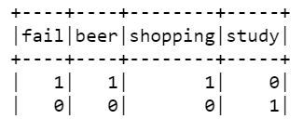
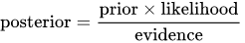
NaiveBayes​
Naive Bayes classifiers are a family of simple probabilistic, multiclass classifiers based on applying Bayes’ theorem with strong (naive) independence assumptions between every pair of features.
eg. If drink beer before exam, will the student fail the exam?
P(fail|beer)=P(fail^beer)/P(beer)
= 1*½ / ½ =1 = 100%

Slide 5
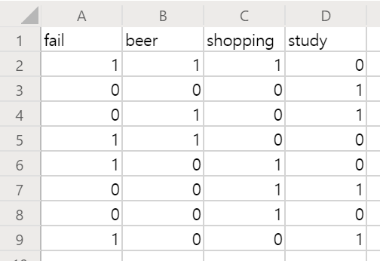
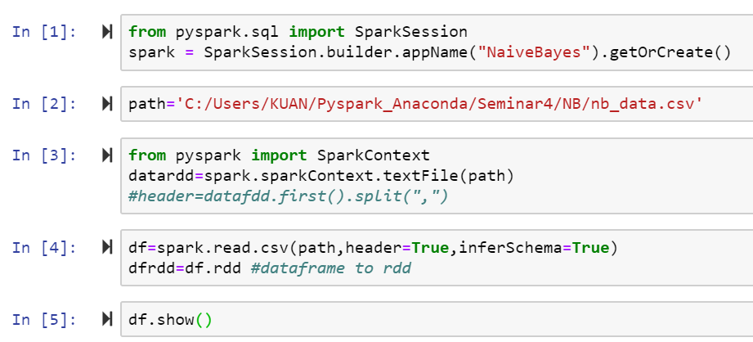
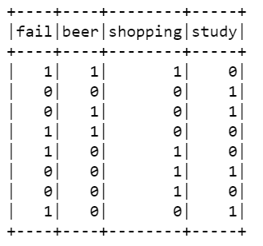
NaiveBayes

Slide 6
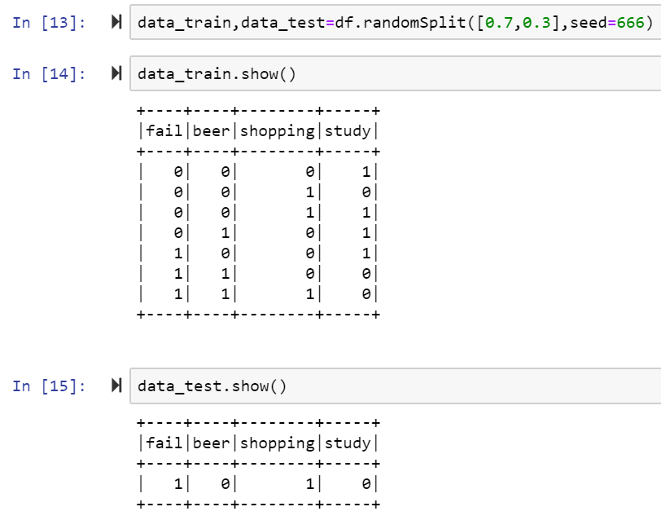
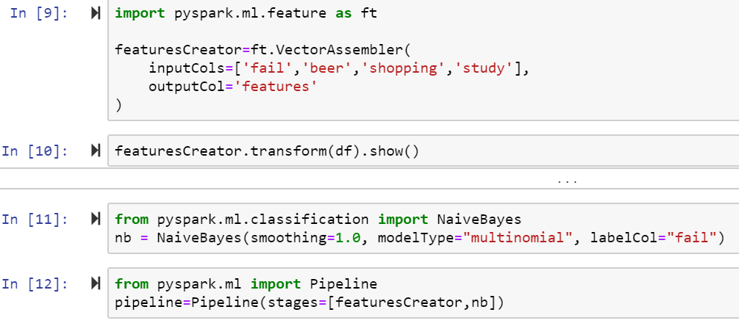
NaiveBayes

Slide 7
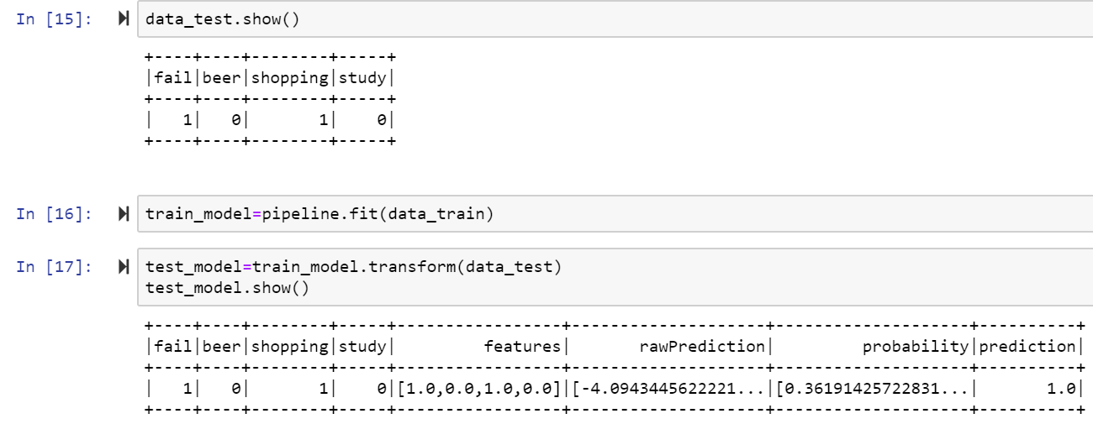
NaiveBayes

Slide 8
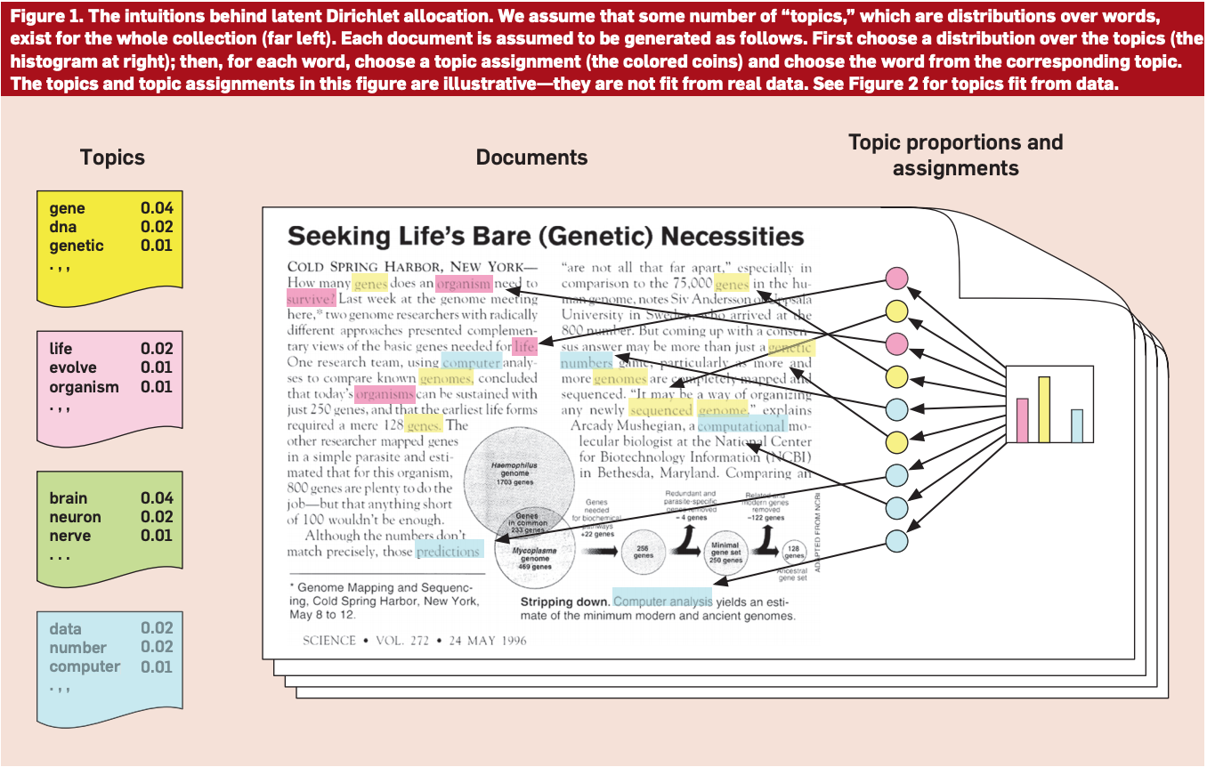
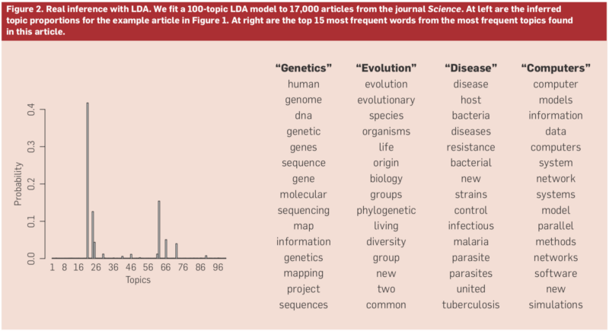
LDA (Latent Dirichlet Allocation)
Latent Dirichlet allocation (LDA) is a topic model which infers topics from a collection of text documents. LDA can be thought of as a clustering algorithm as follows:
Topics correspond to cluster centers, and documents correspond to examples (rows) in a dataset.
Topics and documents both exist in a feature space, where feature vectors are vectors of word counts (bag of words).
Rather than estimating a clustering using a traditional distance, LDA uses a function based on a statistical model of how text documents are generated.

Slide 9
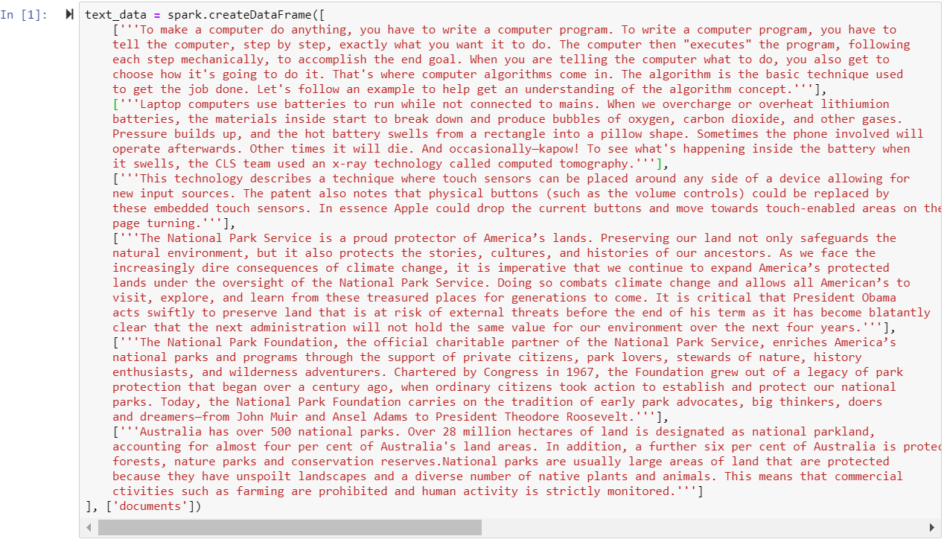
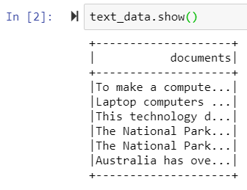
LDA

Slide 10
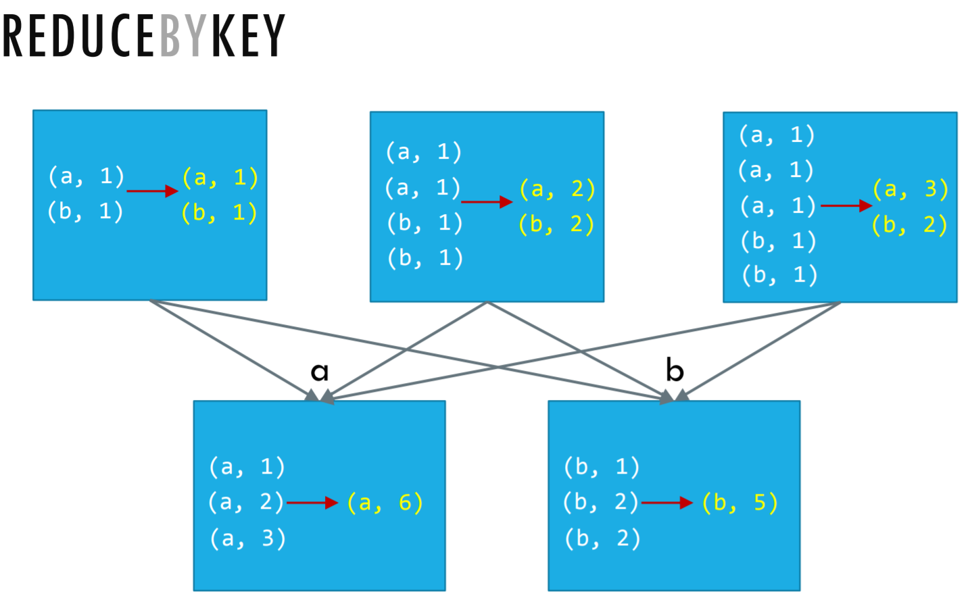
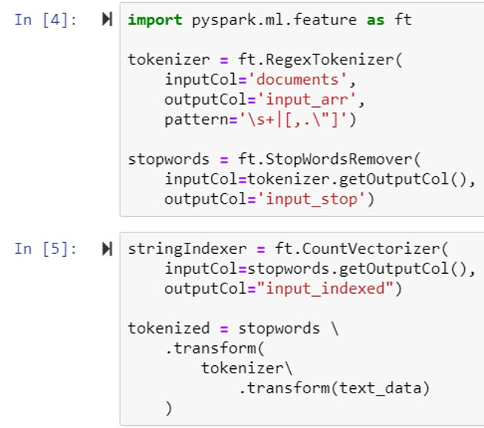
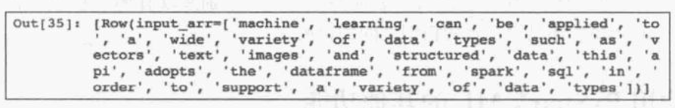
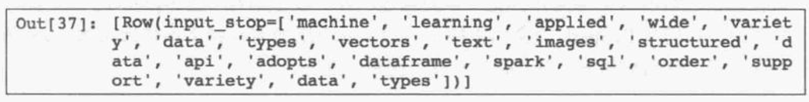
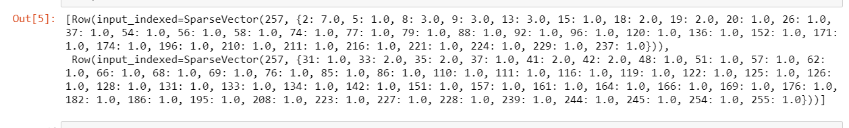
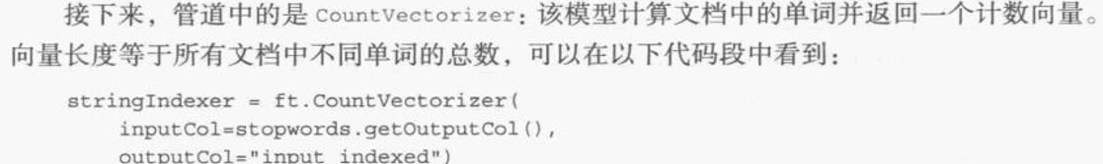
LDA
CountVertorizer:
#計算文檔中的單詞并返回一個計數向量. 向量長度等于所有文檔中不同單詞的總數.
Sum words of the text and return vectors.
Length of Vectors = amount of words

Slide 11
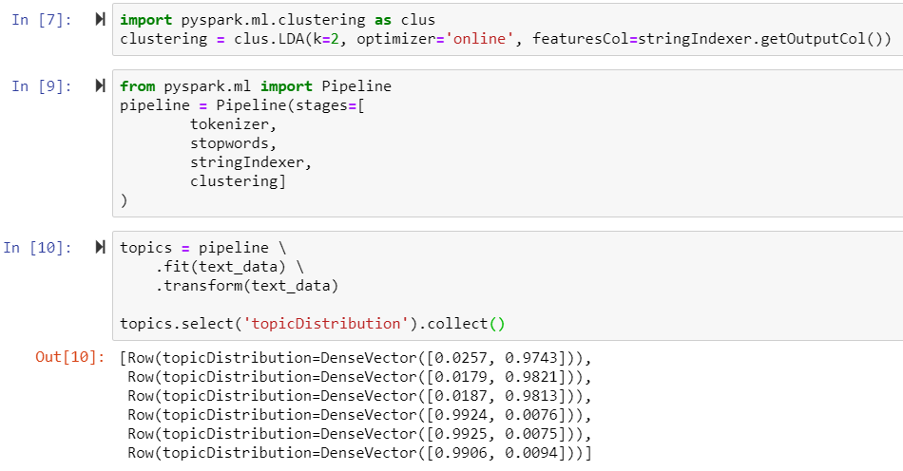
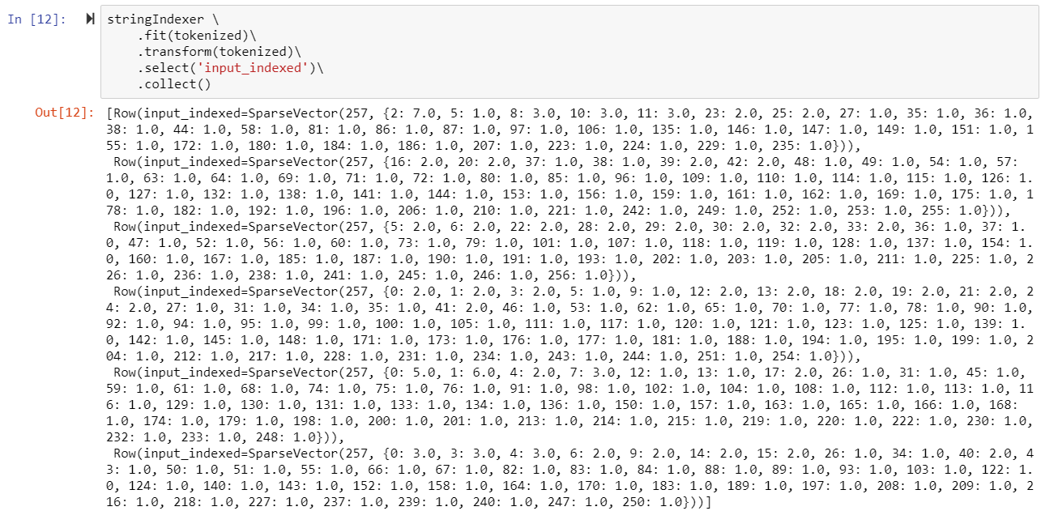
LDA

Slide 13
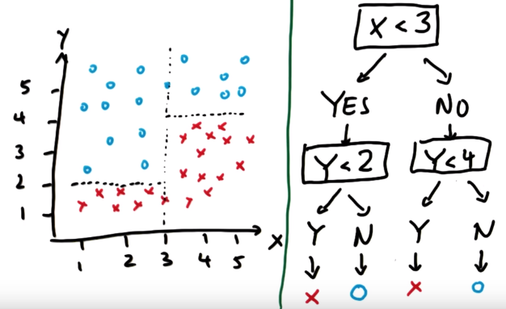
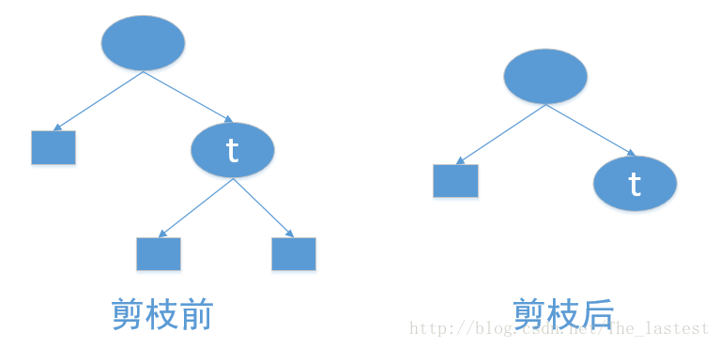
DecisionTree
Feature selection
Decision tree model
ID3
C4.5
CART
Pruning
Pre-Pruning
Post-Pruning

Slide 14
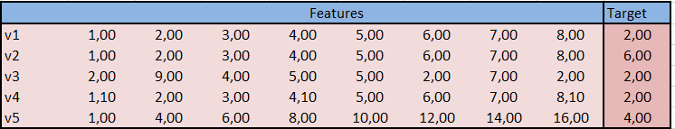
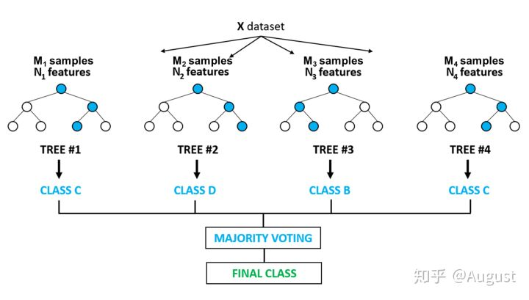
RandomForest​
Ensemble method:
Bagging

Slide 15
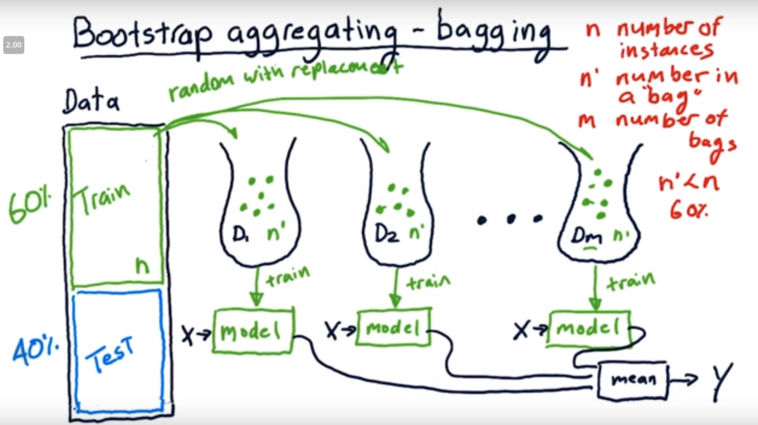
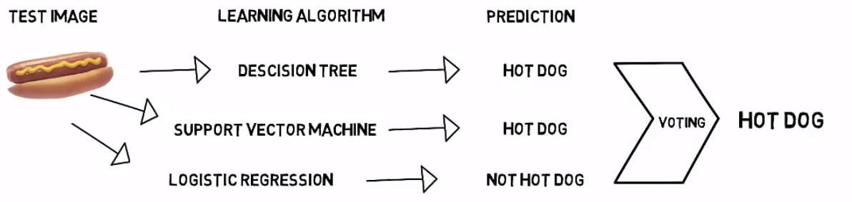
Ensemble method: Bagging
Advantages:
Better accuracy (Low Error)
Higher consistency (avoids overfitting)
Reduces bias and veriance errors

Slide 16
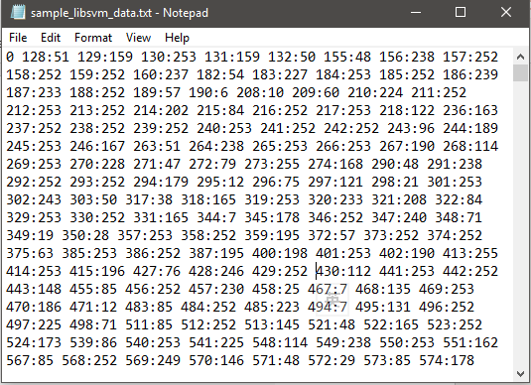
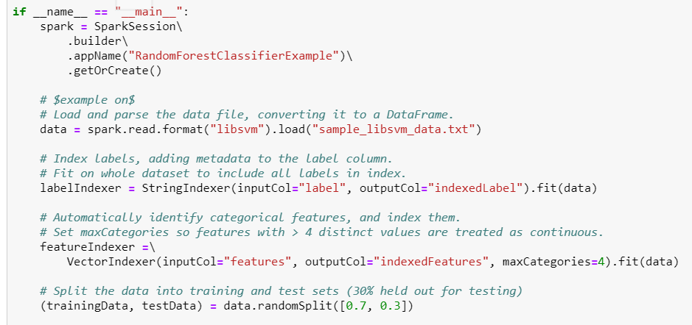
RandomForest

Slide 17
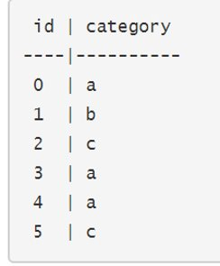
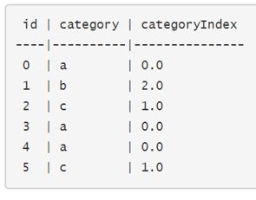
StringIndexer

Slide 18
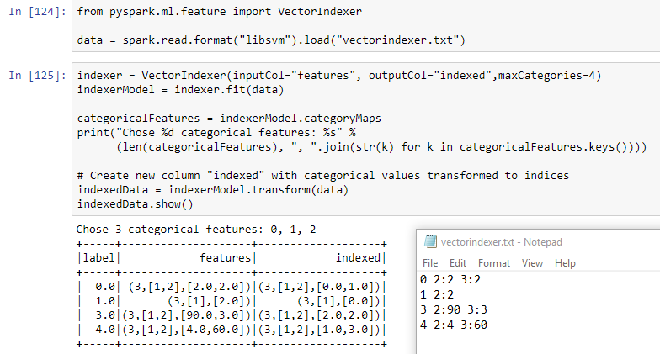
VectorIndexer
VectorIndexer helps index categorical features in datasets of Vectors. It can both automatically decide which features are categorical and convert original values to category indices. Specifically, it does the following:
Take an input column of type Vector and a parameter maxCategories.
Decide which features should be categorical based on the number of distinct values, where features with at most maxCategories are declared categorical.
Compute 0-based category indices for each categorical feature.
Index categorical features and transform original feature values to indices.
Indexing categorical features allows algorithms such as Decision Trees and Tree Ensembles to treat categorical features appropriately, improving performance.

Slide 19
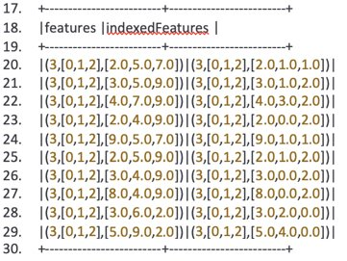
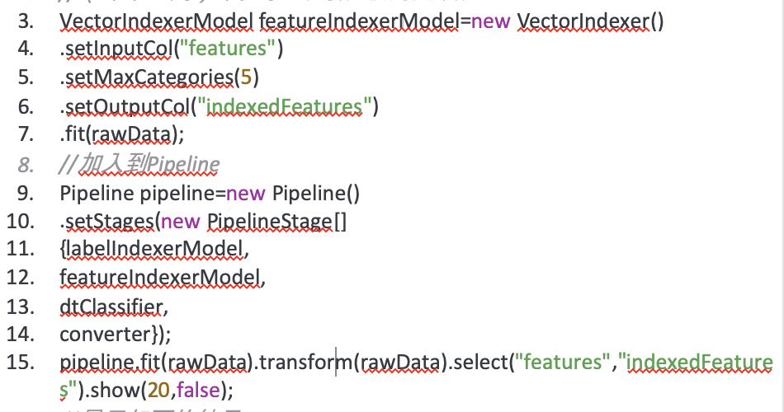
VectorIndexer
^
Continoune
[--^---^--]
- Discrete
4,
5,
6,
7,
9
2,3,4,5,8,9
2,
7,
9

Slide 20
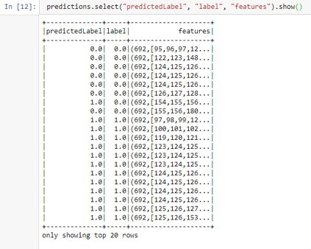
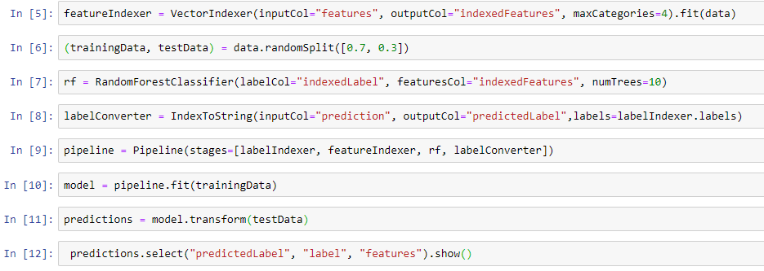
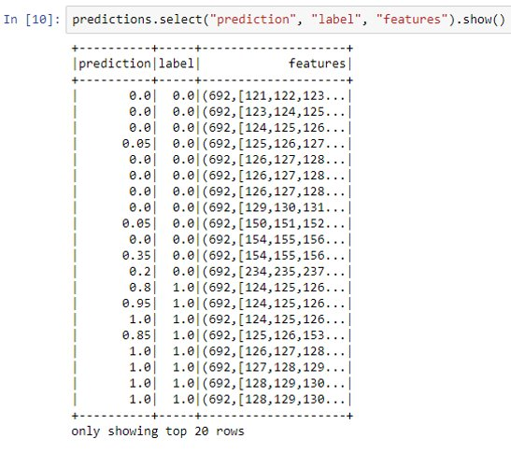
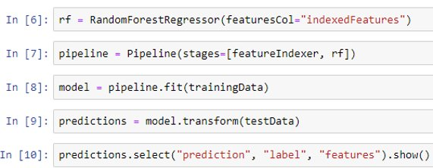
RandomForestClassifier
RandomForestRegressor​

Slide 21
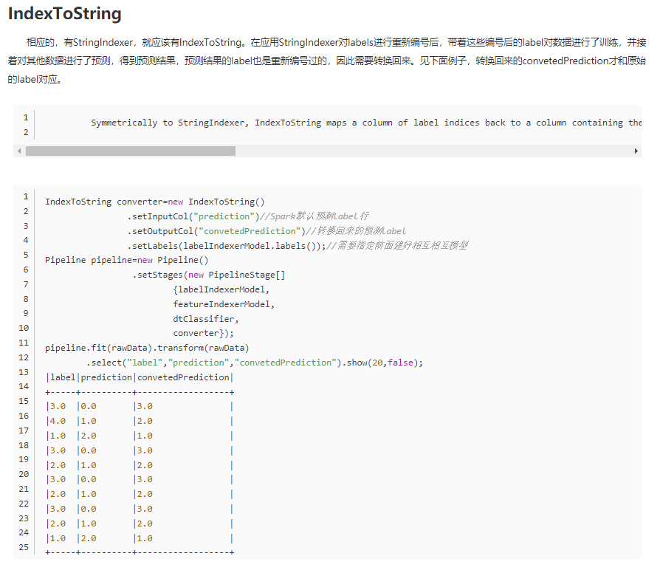
IndexToString

Slide 22
The End Thank you Pyspark ML Agglorithms
21th June 2019
Kuan Sao I

